Slide 1
Project Proposal:
Recinet
Jocelyn Camargo
Peter Rogers

Slide 2
General Idea
Food recipe social network
Different categories of posts: core meals, desserts, holiday recipes, etc.
Different categories can be formatted specifically for that type of food
Users would have their own profiles where they can post pictures and recipes

Slide 3
Why Should We Care?
Earn admiration from sharing recipes with others
Add variety to meal times by trying new recipes they haven't used before
A way for aspiring chefs to put their work out there, with the goal being either employment at or creating their own restaurant
Giving posts an automatic format, without much input required from the user
Photos, videos, recipes

Slide 4
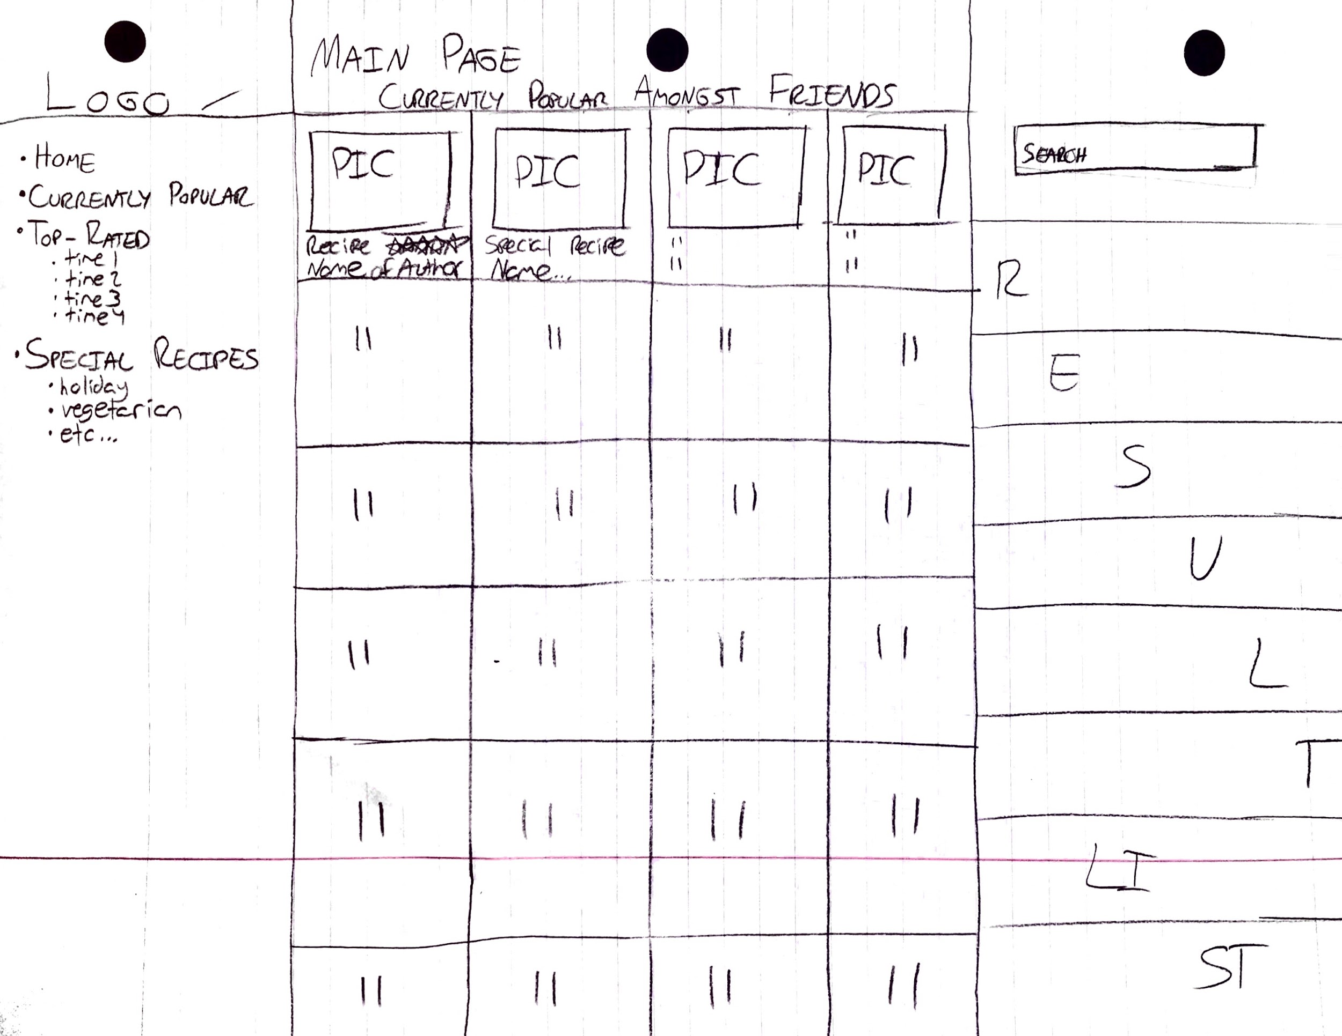
Sketches

Slide 5
Summary
Increase your culinary skills by sharing and creating recipes with friends and family
Creative recipes
Networking with other individuals of similar interests

Slide 6
Rent-a-skateboard
By Briana Guzman and Jamie Lynn Culilap
Notes:
Speaker: Briana

Slide 7

Purpose
“Need a quick ride? Now you can borrow a skateboard without the hassle of owning one!”
Two types of users: Borrowers and Skaters
Renting will be free, unless damage is done.
Great for college students who need to move themselves quickly across the campus!
Notes:
Mention that this will be on mobile

Slide 8
Features
Fundamental Features: Login/logout, notifications, messaging
Scheduling
“Open-Rent” button for Skaters
Borrowers and skaters can be reviewed
Interaction Type: Instructing
Notes:
Protection plan: Skaters have multiple pictures of their skateboard, and borrowers will have to show proof if their damage did not come from them.

Slide 9
Mock-ups
Borrower
Skater

Slide 10
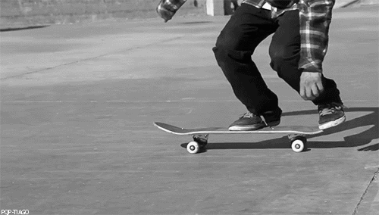
Skate your way into time-saving!
RENT-A-SKATEBOARD

Slide 11
Note Taking App
Ryan Espinosa
Michael Myers
An app that manages ideas and concepts

Slide 12
Purpose When reading notes, it is could be difficult to see relations between ideas and quickly find key concepts
The goal is to make notes more readable and connections between ideas more apparent.

Slide 13
Why care?
The notes are easy to read and write.
It can be used throughout school life whenever note taking or outlining.
Returning to notes for studying, it is easier to remember key concepts and see how the ideas were connected in class.

Slide 14
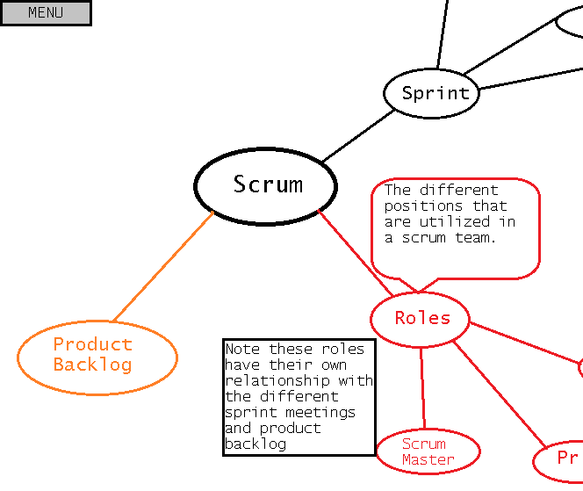
Interaction Type:
Manipulating
FEATURES:
Create and Connect Idea Nodes
Double Click Node and add explanation of concept
Change color of nodes and move them around
Save notes for later study

Slide 15
Summary
Purpose: Application for creating notes centered around concepts and the links between concepts over traditional top-down note taking.
Why Care: Promotes notes that are easier to come back to and review as the core ideas are easily visible with relationships shown.

Slide 16
COT: Card Organizational Tool
Alicia Wong, Matthew Luu

Slide 17
Brief Churning Overview
Churning: utilize creditworthiness to make a lot of money off of sign up bonuses
Minimum spend: how much you need to spend to get the bonus
Most cards have an annual fee
It is common for churners to hold over 10 credit cards
They probably only use one or two
Accounts open are beneficial to credit score - age of accounts
Notes:
Annual fee, cancelling, benefits

Slide 18
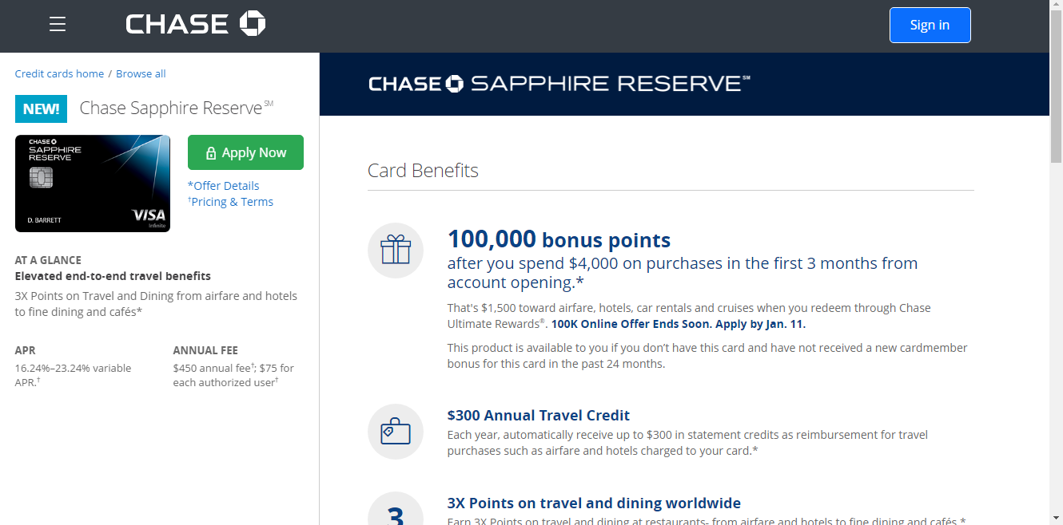
Example

Slide 19
Purpose
To create a tool in order to track aspects of all your credit cards
Rewards / reward type
Signup date / Approval date / Expiry date
Credit limit
Minimum spend requirement / minimum requirement date
To attempt to negate a downfall of churning
Not cancelling cards on time and being hit by a second annual fee
Not meeting the minimum spend requirement to get the bonus

Slide 20
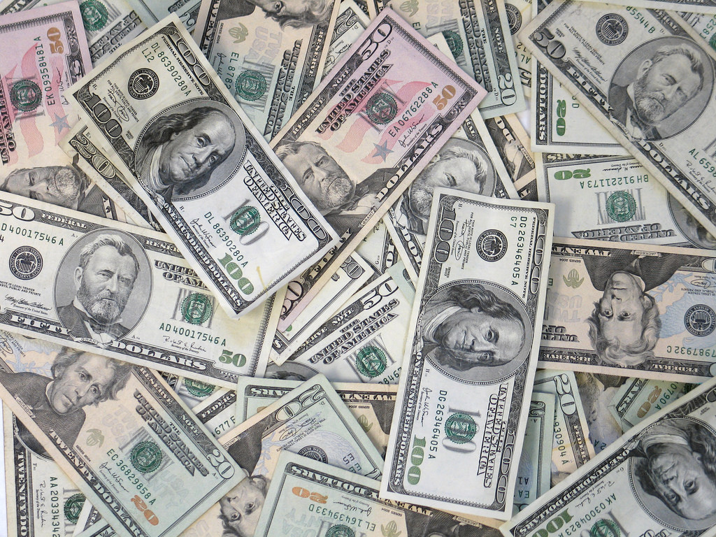
Why should you care?
MONEY

Slide 21
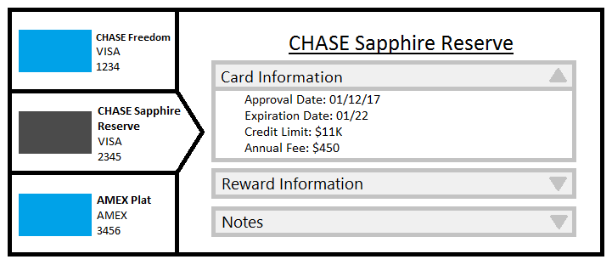
Mockup of Potential Interface

Slide 22
TL;DR
Very lucrative practice that can net someone a lot of money
No tool currently built for just churners
Helps assist just the average person to be organized financially
Tool is simple to make but provides a large benefit

Slide 23
PIANO prodigy
Isabelle Tran
Drew Overgaard

Slide 24
Purpose
Create an interactive and engaging way To learn how to play Piano and read music using a touch screen device
difficulty of songs made to progress at users’ pace
Convenient way to expand your Musical horizons

Slide 25
Why You should care!
Cost effective way to learn an enriching skill
No need to purchase piano or pay for lessons
Learn at your own pace, time, place
Made to work on Touchscreen devices

Slide 26
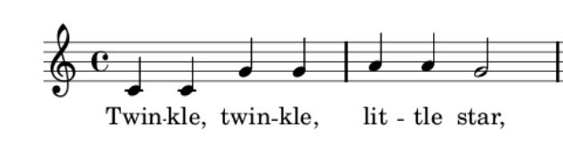
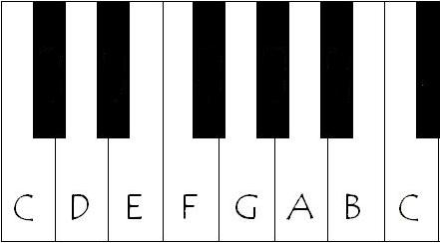
Mock UP
Current Song:
Twinkle, Twinkle Little Star
PAUSE
EXIT
CHOOSE NEW SONG

Slide 27
Mock UP
Current Song:
Twinkle, Twinkle Little Star
PAUSE
EXIT
CHOOSE NEW SONG

Slide 28
Mock UP
Current Song:
Twinkle, Twinkle Little Star
PAUSE
EXIT
CHOOSE NEW SONG

Slide 29
Social Media Search Tool
Norlan Prudente
Tianxiang Ben Liu
Notes:
Introduction

Slide 30
What are we creating?
Social Media Search Tool
Search keyword(s) in social media (Twitter), get all related data at once, and get visualization if you want.
Features: Search/ Sort/ Visualize
Key words: User Experience, User Interface, Social Media Analysis, Data Visualization

Slide 31
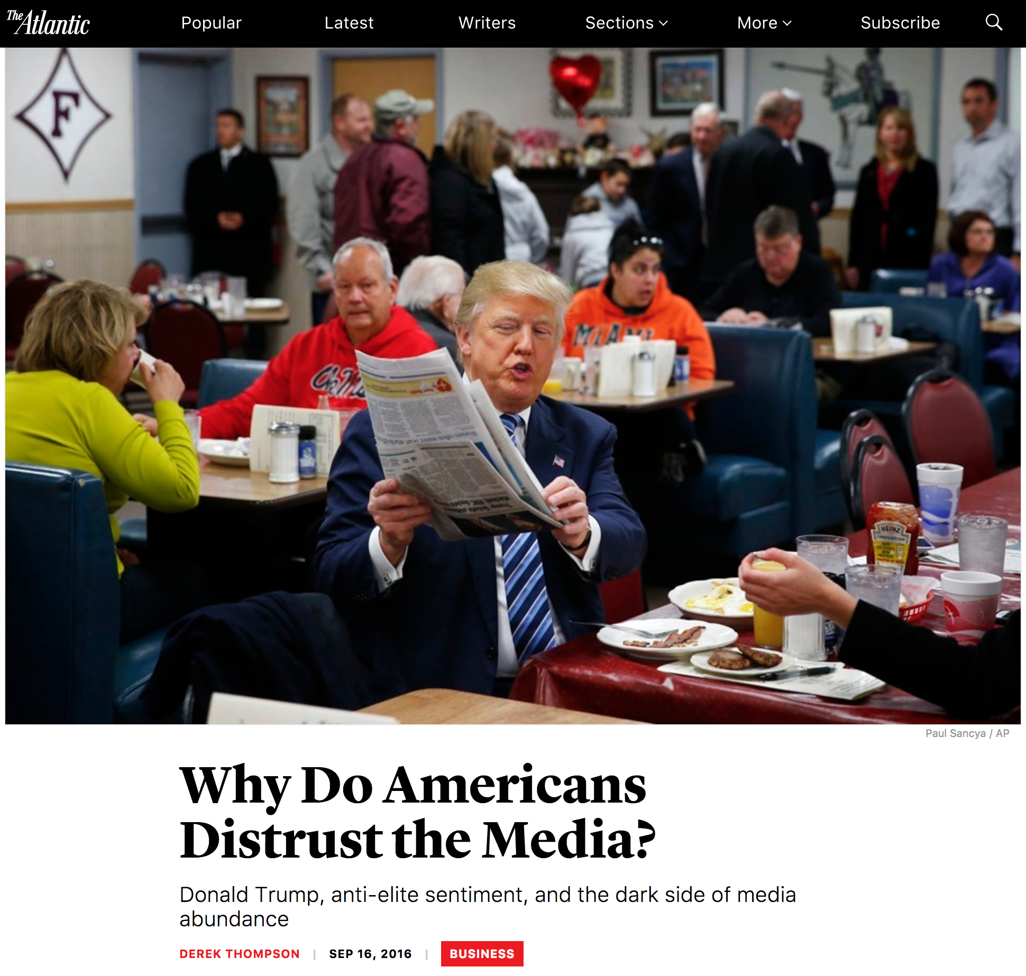
Why we need this project?
https://www.theatlantic.com/business/archive/2016/09/why-do-americans-distrust-the-media/500252/

Slide 32
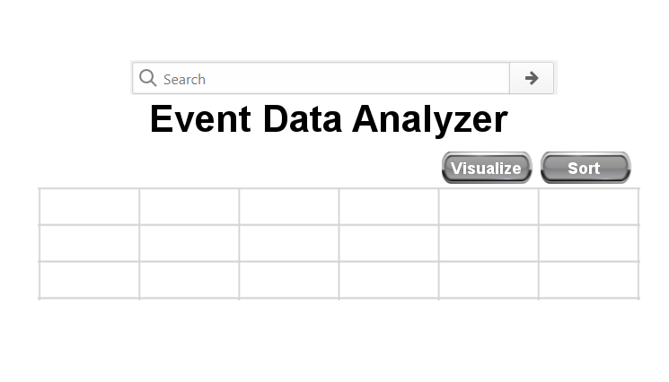
Interface
Interaction Type: Instructing

Slide 33
Summary
Get your own data for research
Sort data
Visualize data for readability

Slide 34
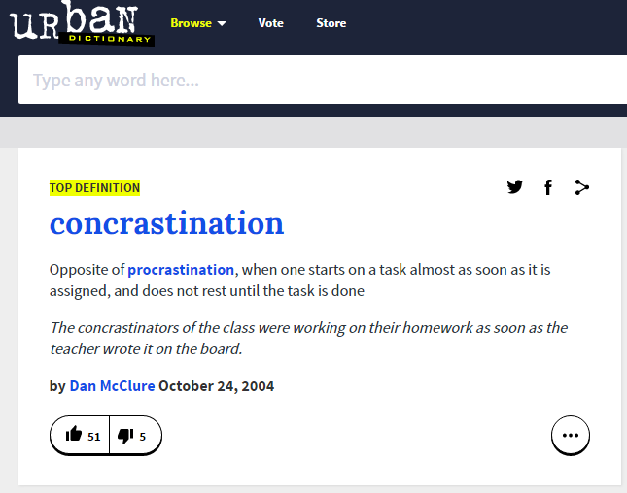
Concrastinate
By Tom Vo & Jaskaran Virk

Slide 35

Purpose of Concrastinate
What is Concrastinate?
Student schedule planning application
Allows planning of work and build strong study habits
Input tasks from syllabus (exams, homework, etc.)
Depending on category of tasks and numerous other factors
Calculates necessary studying/work time
When to start the task, time left till deadline, notifications
Factors: Difficulty of course, task type, team or group assignment

Slide 36

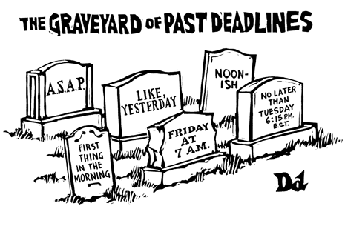
Why Should You Care?
Concrastinate can help ease or even resolve time conflicts for our demographic
Colleges students do a lot outside of academic
= harder to plan
You can easily lose track of due dates
Fight poor studying habits with Concrastinate

Slide 37
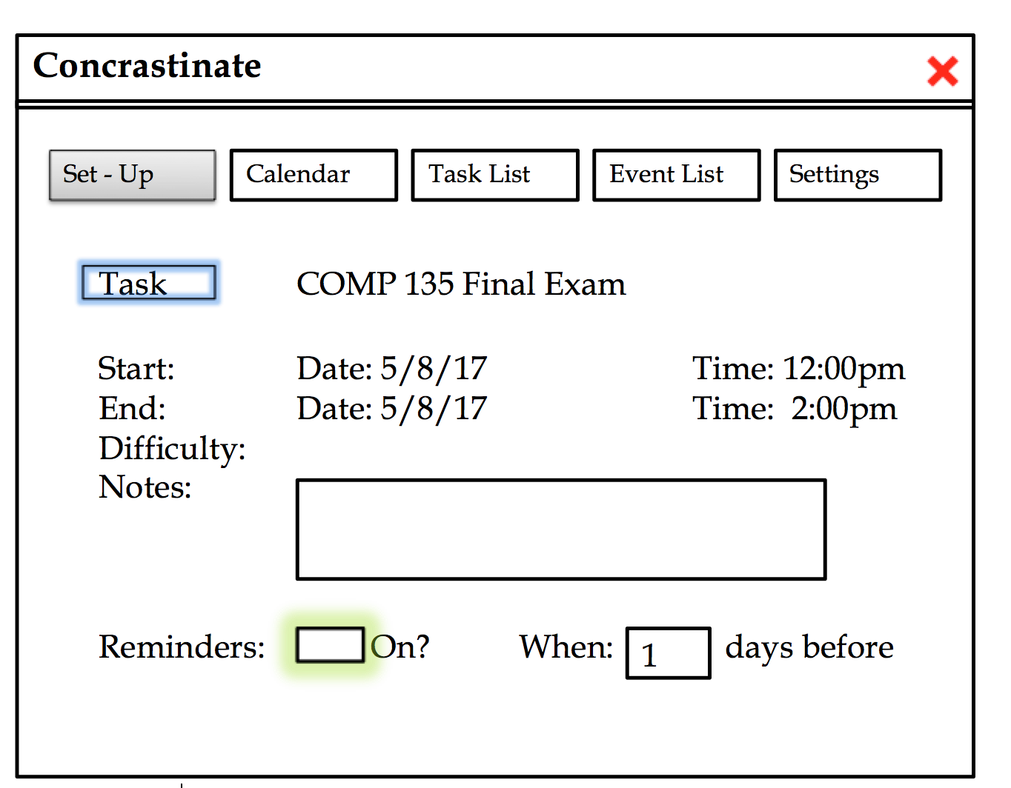
Sketch Model

Slide 38

Vote!
If you need improved…
Time management
Productivity
Study habits
It’s time to make event planning simple.
It’s time to Concrastinate.
“Get your work done now!”

Slide 39
Tap Away
By:
Luke Weinberg
Kyle Hartman

Slide 40
Purpose
An application to keep you busy for a short time
Have some fun making music
Explore your creativity through both music and voice
Learn not only how various instruments sound, but the general background

Slide 41
Why you should care
Can be a creative tool to learn about various instruments, while also being able to see how the instrument sounds
“Tap away” is not only an application from which you can pass time , it’s an exploration into the world of musical genres, various sounds and frequencies.
A fun creative project and idea to work on

Slide 42
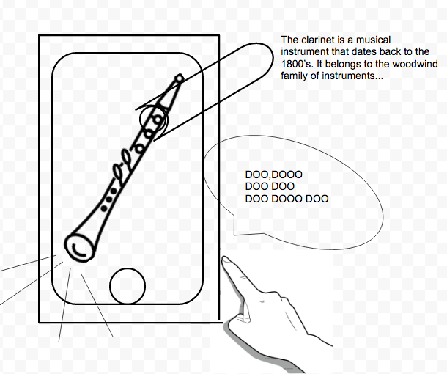
Sketch
Interaction design:
“Tap away” utilizes the instructive interaction type in which through voice commands we can instruct the application to play sounds, as well as when the user touches certain areas, music is played.
Users would have a fun and simple time maneuvering through this application learning new things, and developing a creative environment/ atmosphere

Slide 43
Summary
An application that allows the user to create and learn about music
The power to control music at your fingertips
The ability to use your voice as an instrument

Slide 44
Simple Budget Manager
An Nguyen - Kyle Cookerly

Slide 45
Purpose of the Project
Create an easy -to-use interface targeted towards first-time budgeters and college students
Aims to help users keep track of their finances
Allow users to set and meet their own financial goals
Support for the simple splitting of expenses for group living arrangements

Slide 46
Why should you care
Budgeting can help make it easier to make the money we have go as far as possible
Tools that are similar to this often have unfriendly and hard-to-use interfaces
With a web-based design, you will have access to your budget plan wherever you go with a simple login
Built in features such as graphs will allow you to see how your money management has improved over time

Slide 47
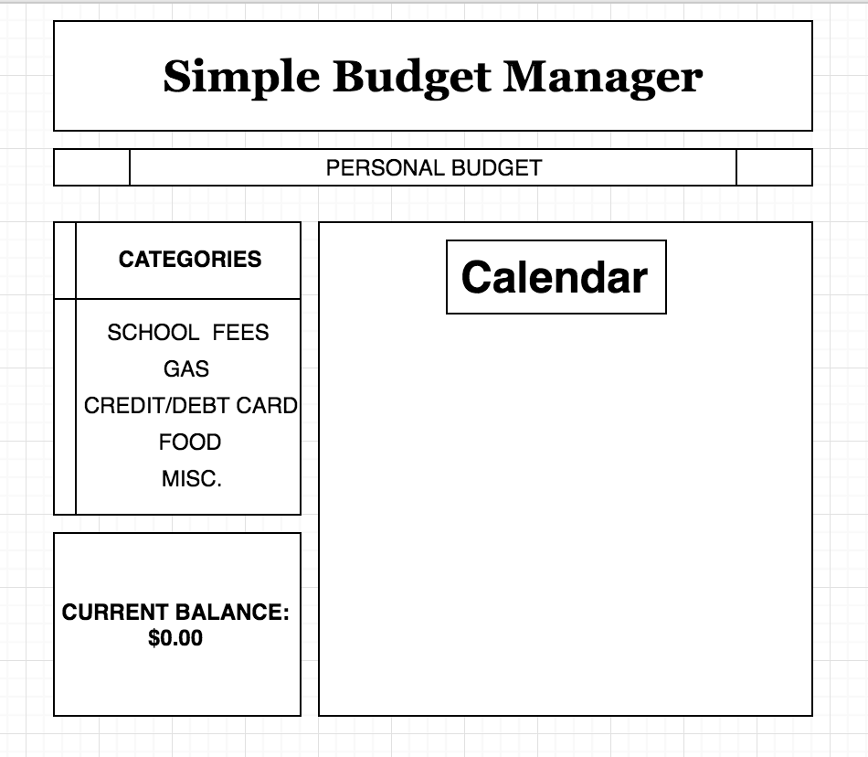
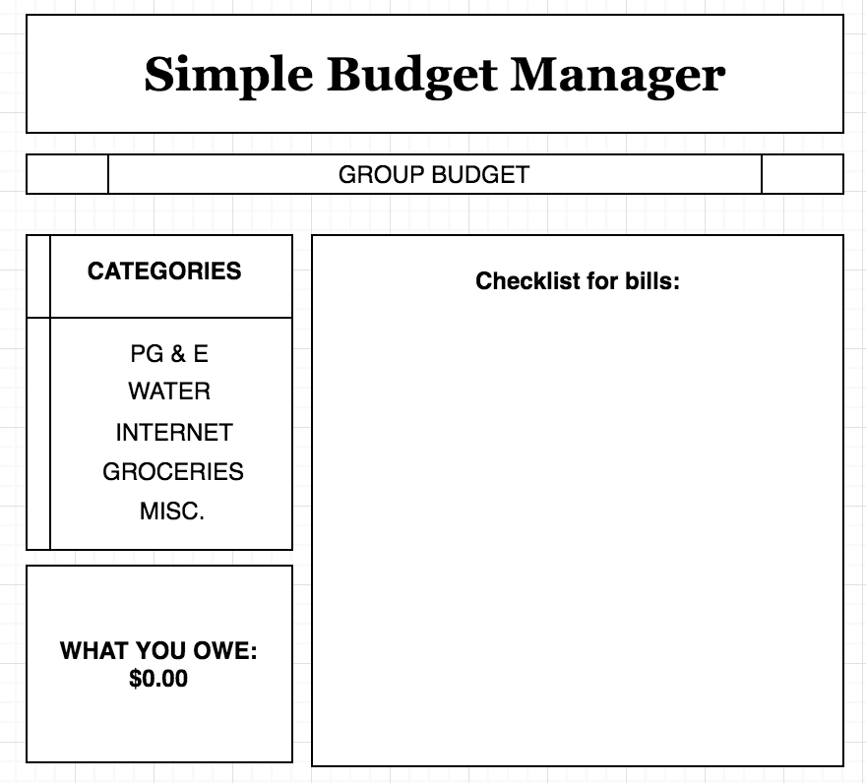
Mockup - Instructing Interaction Type

Slide 48
Closing Thoughts
No need to use an old fashioned pen and paper based budget
Responsive, web-based design for easy access anywhere
Attention to the need for an easy-to-use interface
Support for the creation of groups from multiple users which will allow the sharing of expenses
Allows users to learn budgeting skills that will follow them throughout their life

Slide 49
Project courier: an instant messaging experience
By Sam Bald and Kyle Phan

Slide 50
Purpose
To be able to communicate with your friends on a unique messaging platform
Anyone can join easily through our convenient user interface
Unique features such as using your heart-rate to provide an authentic emotional interaction with your friends

Slide 51
Why you should care
Messaging apps today are cluttered
Messaging apps today are insecure
Messaging apps today are full of ads
Messaging apps today are impersonal
Ours is NONE of those things!
Simple
=
Good

Slide 52
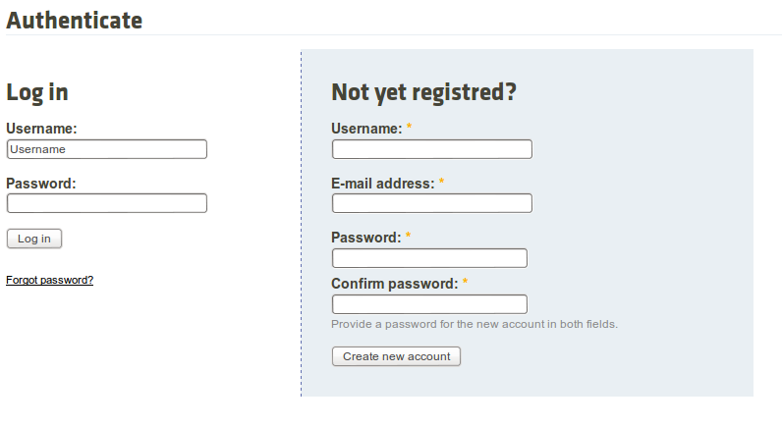
Mock-up
Sign Up

Slide 53
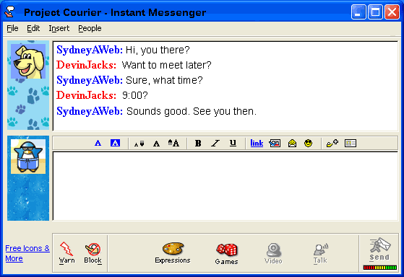
Mock-up
Messaging

Slide 54
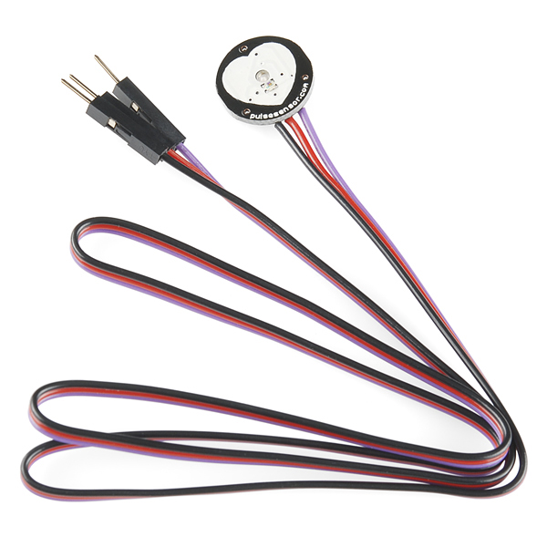
Mock-up
Heart-rate texts
Heart rate sensor to be hooked up to an Arduino →

Slide 55
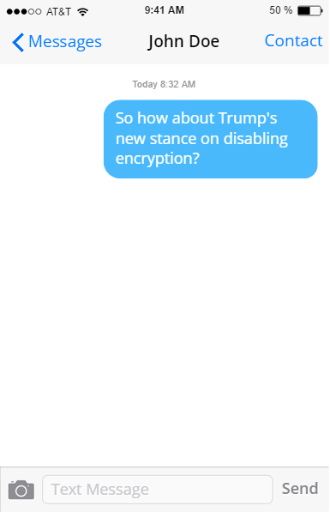
Mock-up
Heart rate = 65bpm (resting)

Slide 56
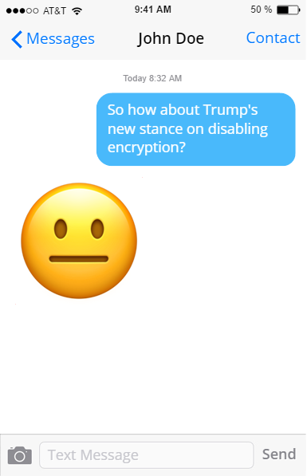
Mock-up
Heart rate = 65bpm (no change)

Slide 57
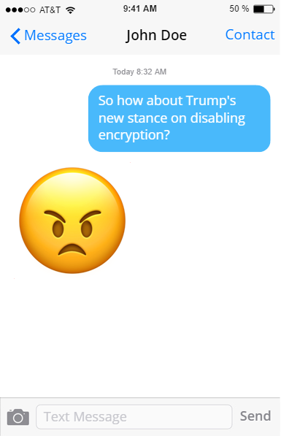
Mock-up
Heart rate = 105bpm (increase)

Slide 58
Review
Project Courier will be the next evolution in instant messaging
Easy, fun access to peers and friends
Authentic, clutter free communication through a simple web interface

Slide 59
Word.
Nate Verlin and Eric Beutler

Slide 60
What.
An interactive word game.
Building words from letters.

Slide 61
Why.
For fun.
Challenge yourself.
Different ways to implement.

Slide 62
How.
Example:
a-e-i-f-t-y-u
From the letters we can make:
fate, feat, yeti, eat, fat, tea, yet, if, and many more.

Slide 63
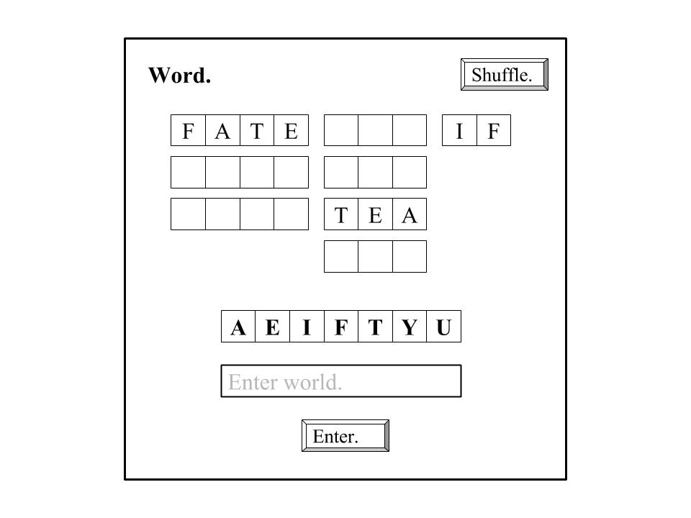

Slide 64

January 27, 2017
Mitchell Chang, Clement Garcia

Slide 65
Audience
-People in need of entertainment.
-People who enjoy classic games.

Slide 66
Purpose
A bundle of games that is meant to entertain a variety of different types of audiences.
Does not require much thinking or attention span due to its simplicity.
Can also be played with a friend (if you have any).

Slide 67
Why pick it?
-Pretty simple.
-Easily expandable
-Good balance of time and planning .
-More fun to create and play Vidya Gamez than researching/creating serious applications.

Slide 68
Games
-Tic-Tac-Toe *
-Hang-Man
-Rock-Paper-Scissors *
* can be played against computer or another player

Slide 69
Design
Vidya Gamez
Pick a game:
Vidya Gamez
Tic-Tac-Toe
Pick a mode:
Hang-Man
Vs. Computer
Tic-Tac-Toe
Vs. player
Rock-Paper-Scissors
Main Menu
When clicking Tic-Tac-Toe. (Kind of the same when clicking Rock-Paper-Scissors)

Slide 70
More Design
Rock-Paper-Scissors
Tic-Tac-Toe
Rock
O
O
X
Paper
X
Scissors
O
X
When choosing Rock-Paper-Scissors
When choosing Tic-Tac-Toe

Slide 71
More Design
Instructing: You can instruct it to open up which game you would like to play. Also can instruct it which options you would like to choose.
Conversing: Not really conversing since you’re not having a conversation with the machine. You’re just choosing the options you are given.
Manipulating: No manipulating anything either. You’re not positioning anything. Simply just pressing buttons.
Exploring: Some exploring? We guess the main menu allows the user to explore each game. The program exploits and assumes that the user already knows how to play these games as well.
Hang Man
H _ N G _ _ N
H
P
K
N
G
M
B
J
I
A
D
L
When choosing Hang Man

Slide 72
Summary
What: A bundle of fun, classic games
Why: Fairly simple, easily expandable, and fun to implement
Bottom Line: Choose this project or else...

Slide 73
End

Slide 74
Reddit: One Handed
A project proposal

Slide 75
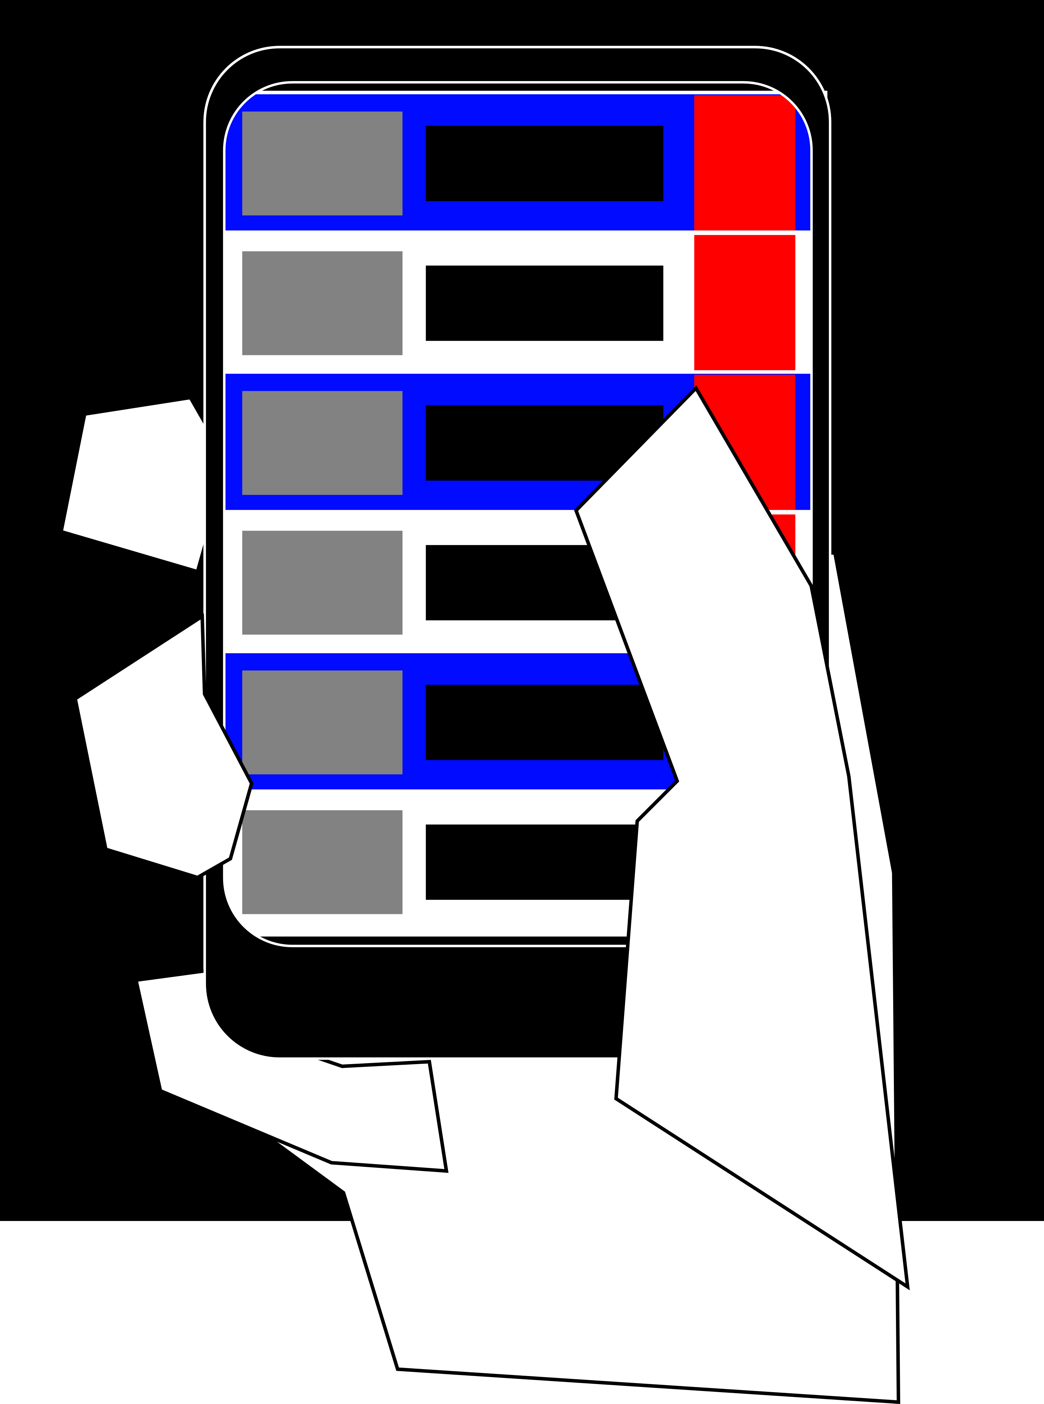
the revision
Optimizing an app for use with a single hand
Discover alternative designs for single hand use
Will be using the content driven website of reddit for prototyping

Slide 76
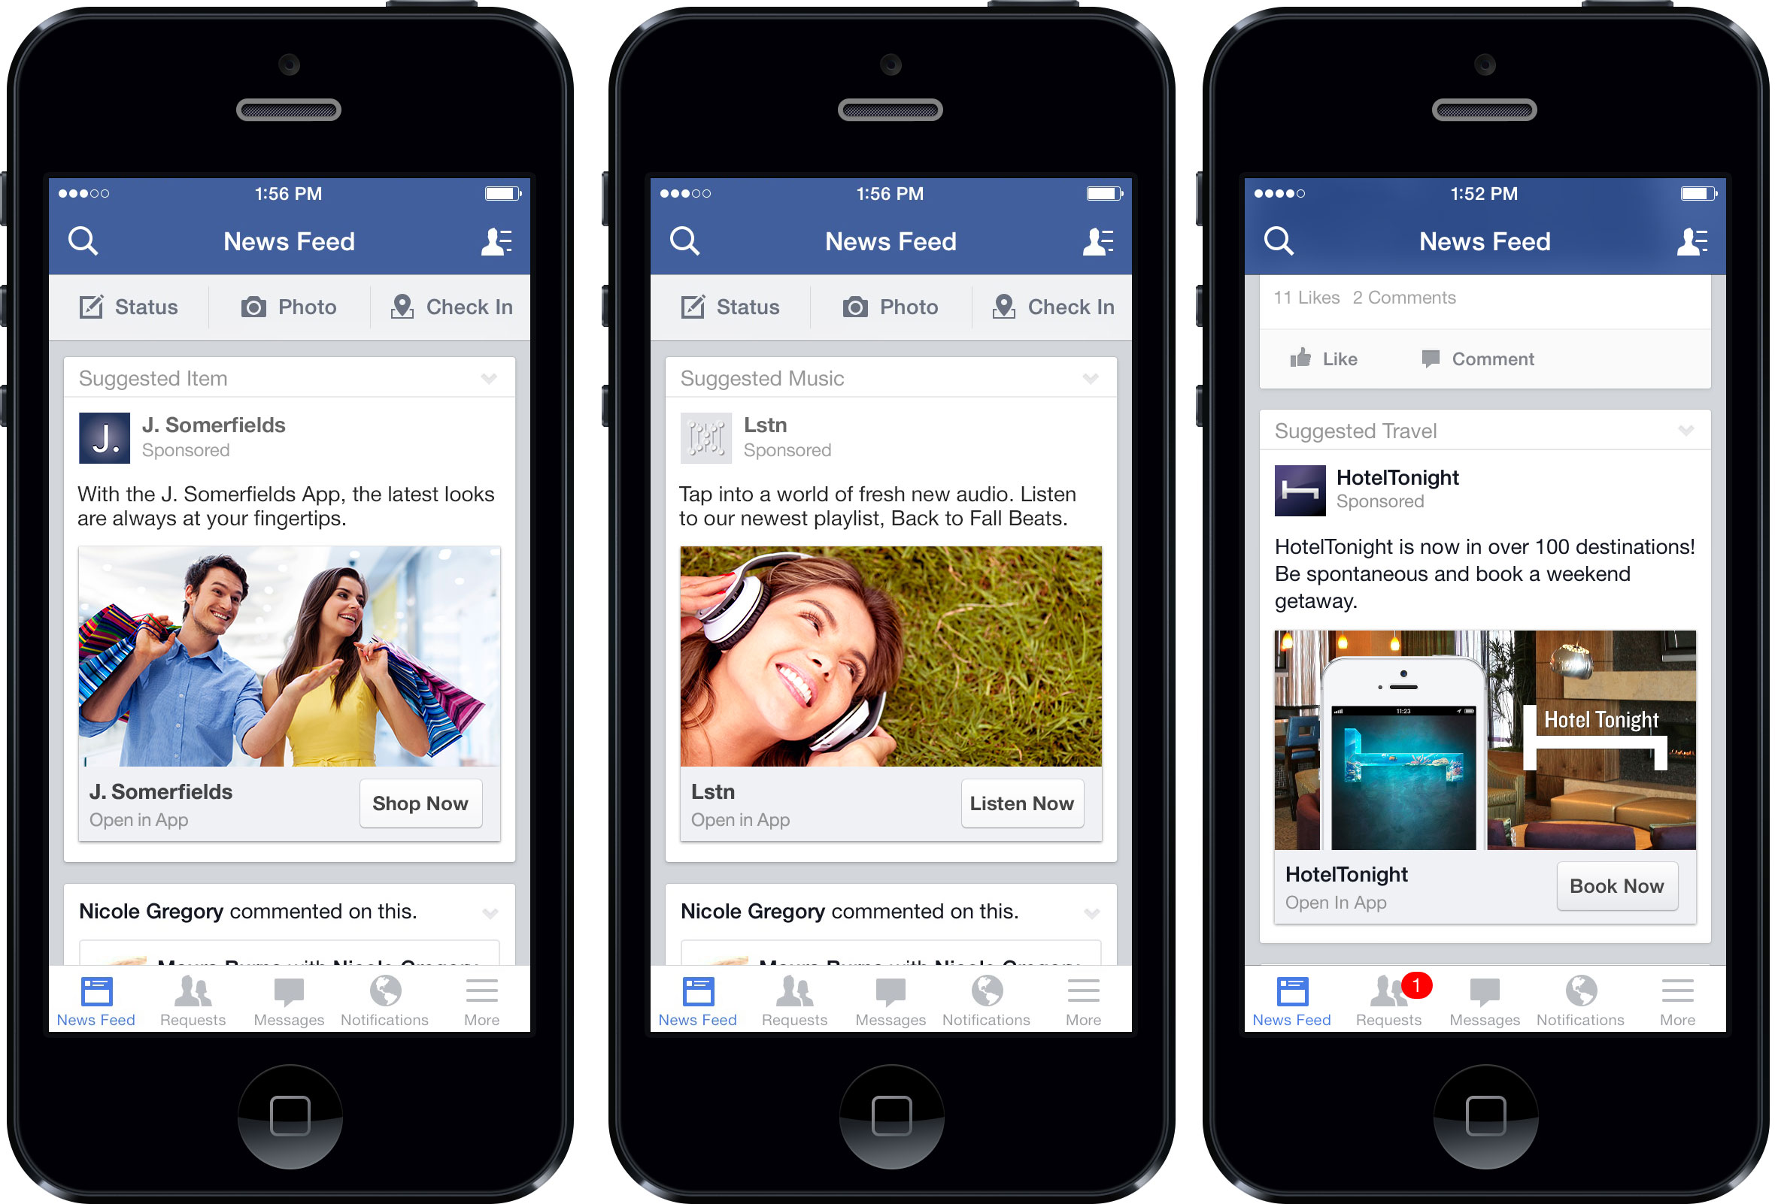

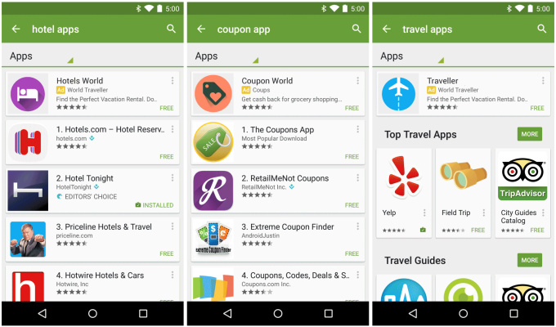
why it’s needed
Modern apps do not consider how people use their phones
Task bars
Hamburger menus
Vertical drop down menus
A new style guide for mobile apps

Slide 77
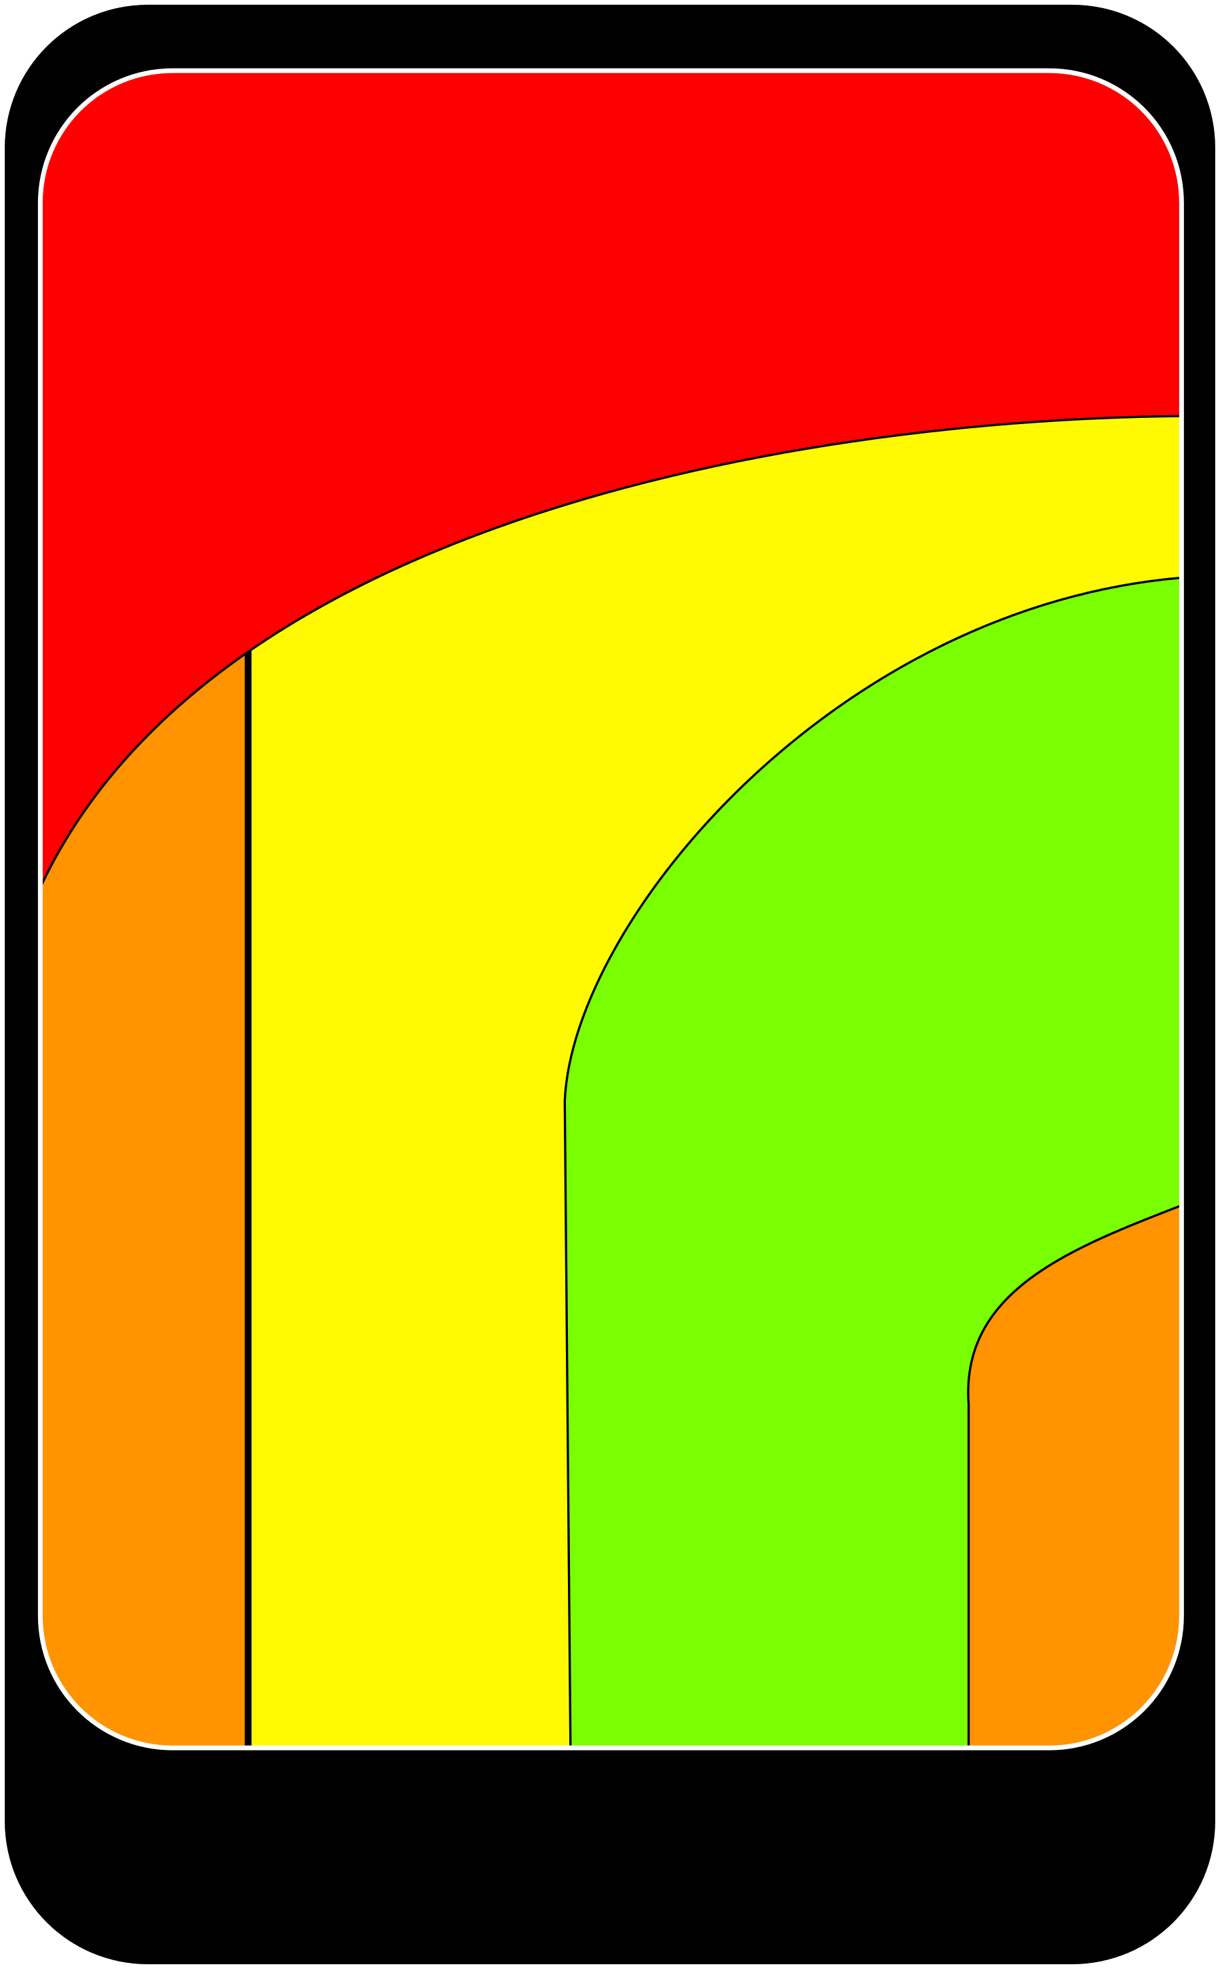

the inspiration
An app designed with the human hand in mind
Limitations of the thumb
Has a pivot for access
Red = inaccessible w/o stretch
Orange = not preferred
Yellow = comfortable
Green = the sweet spot
Mixture of: Exploring and Manipulating

Slide 78
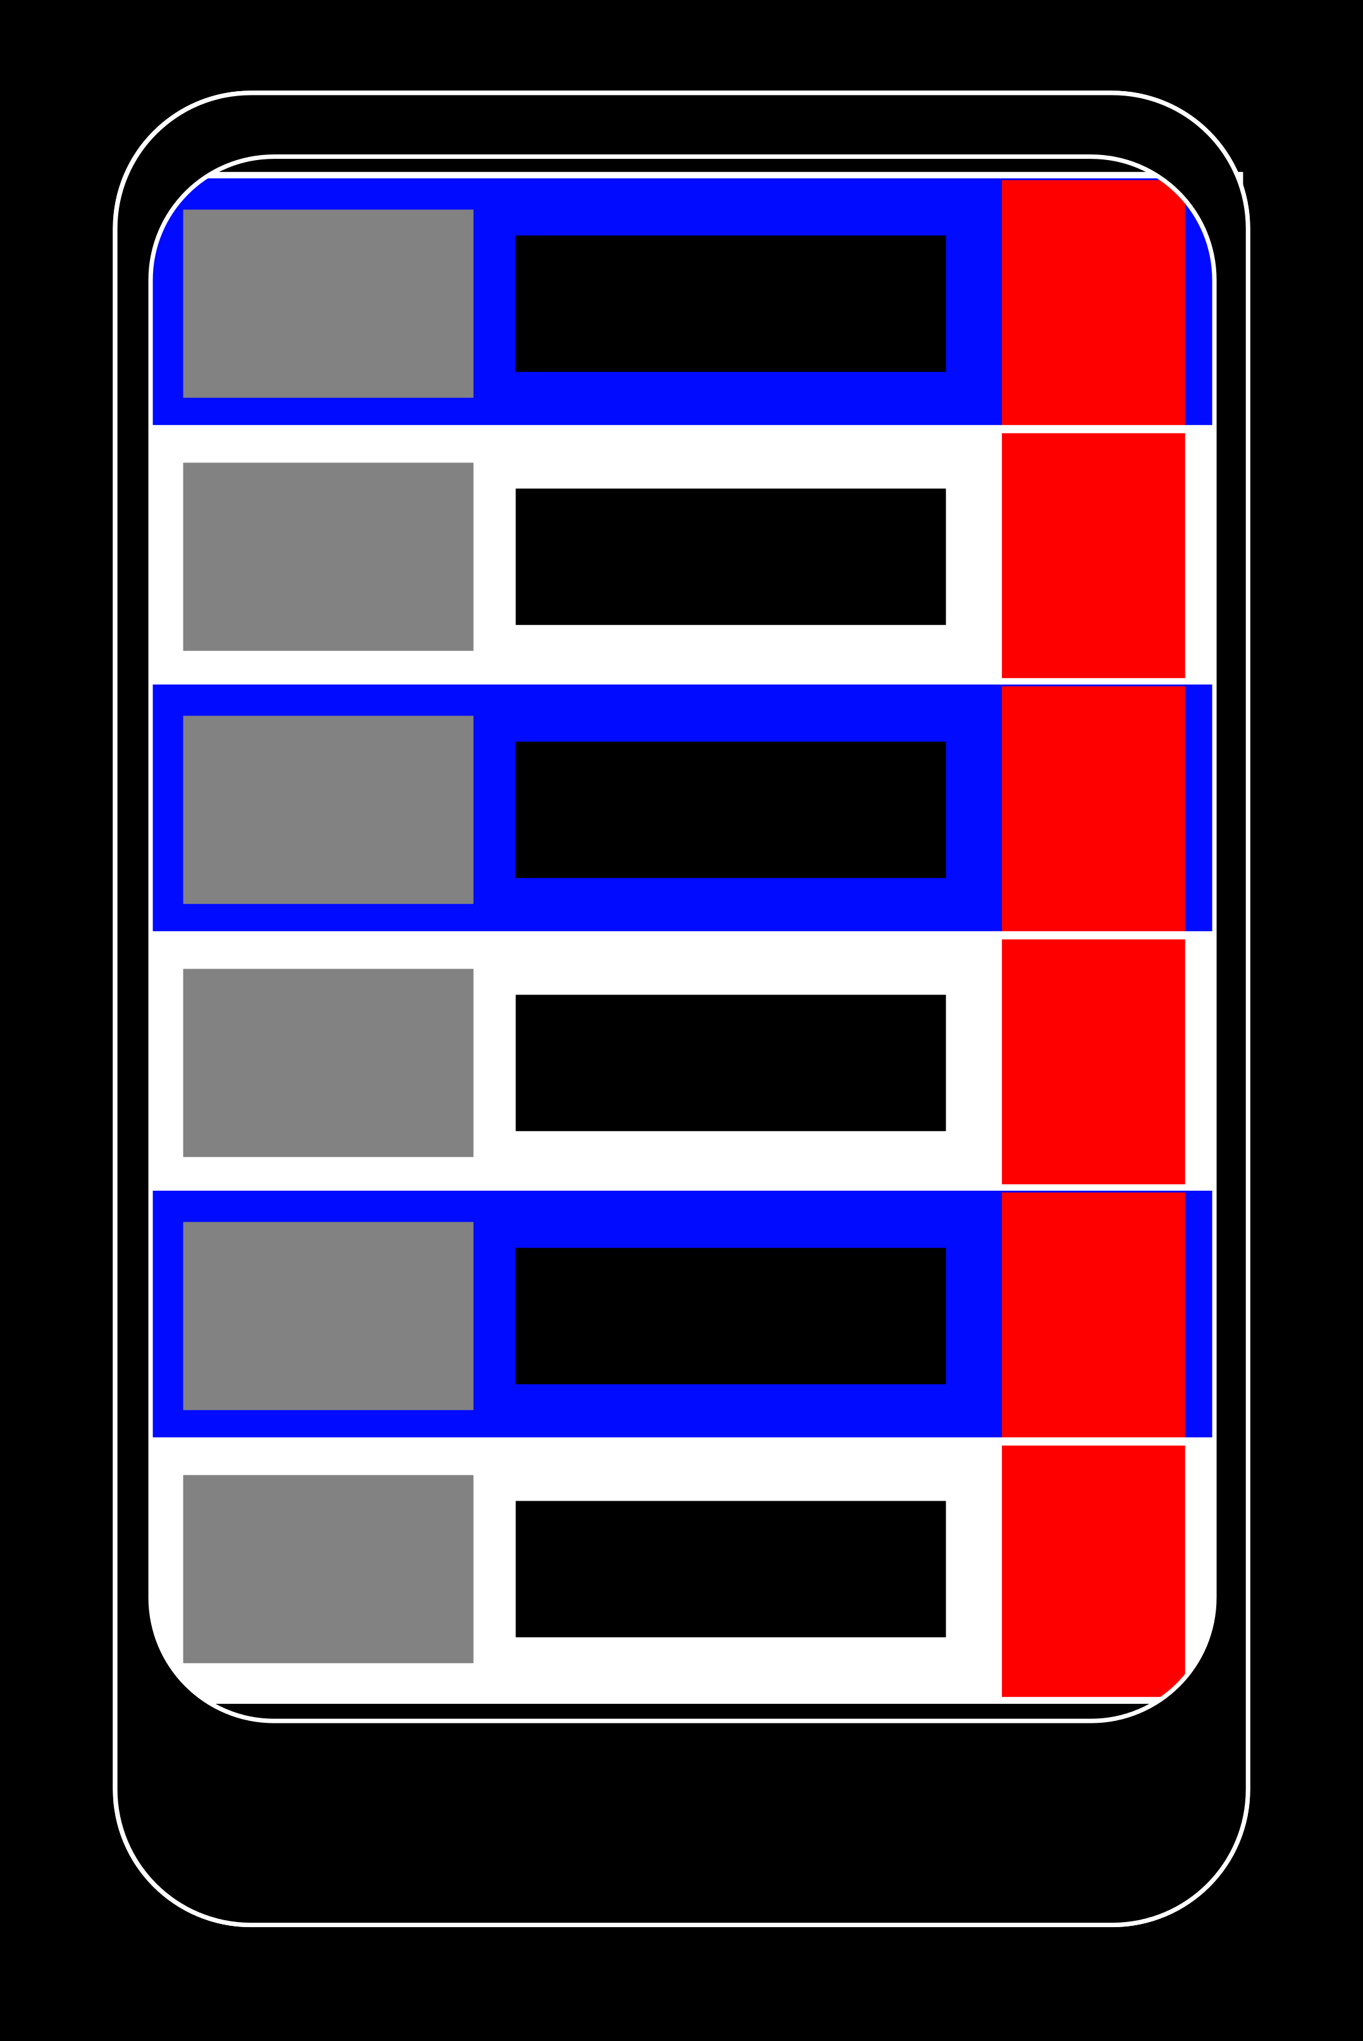
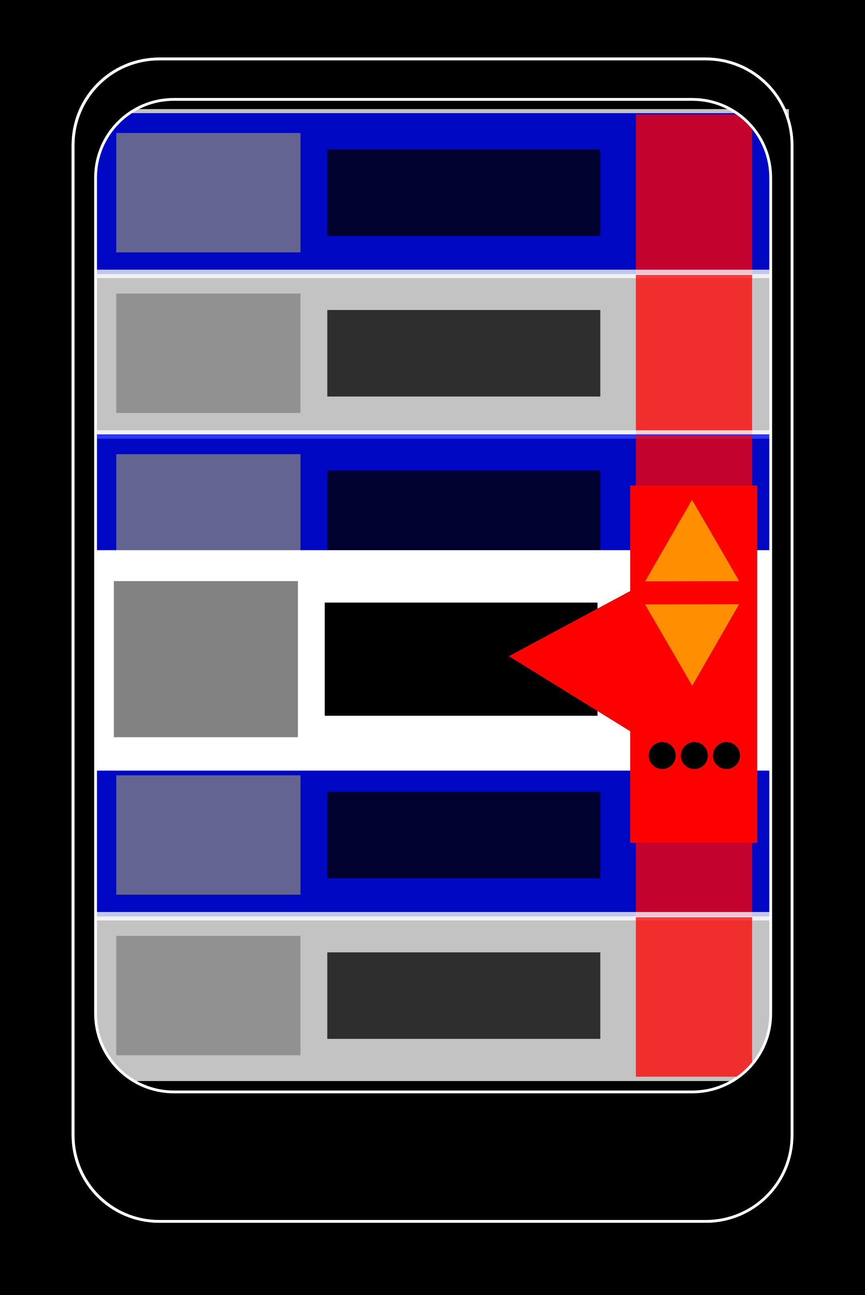
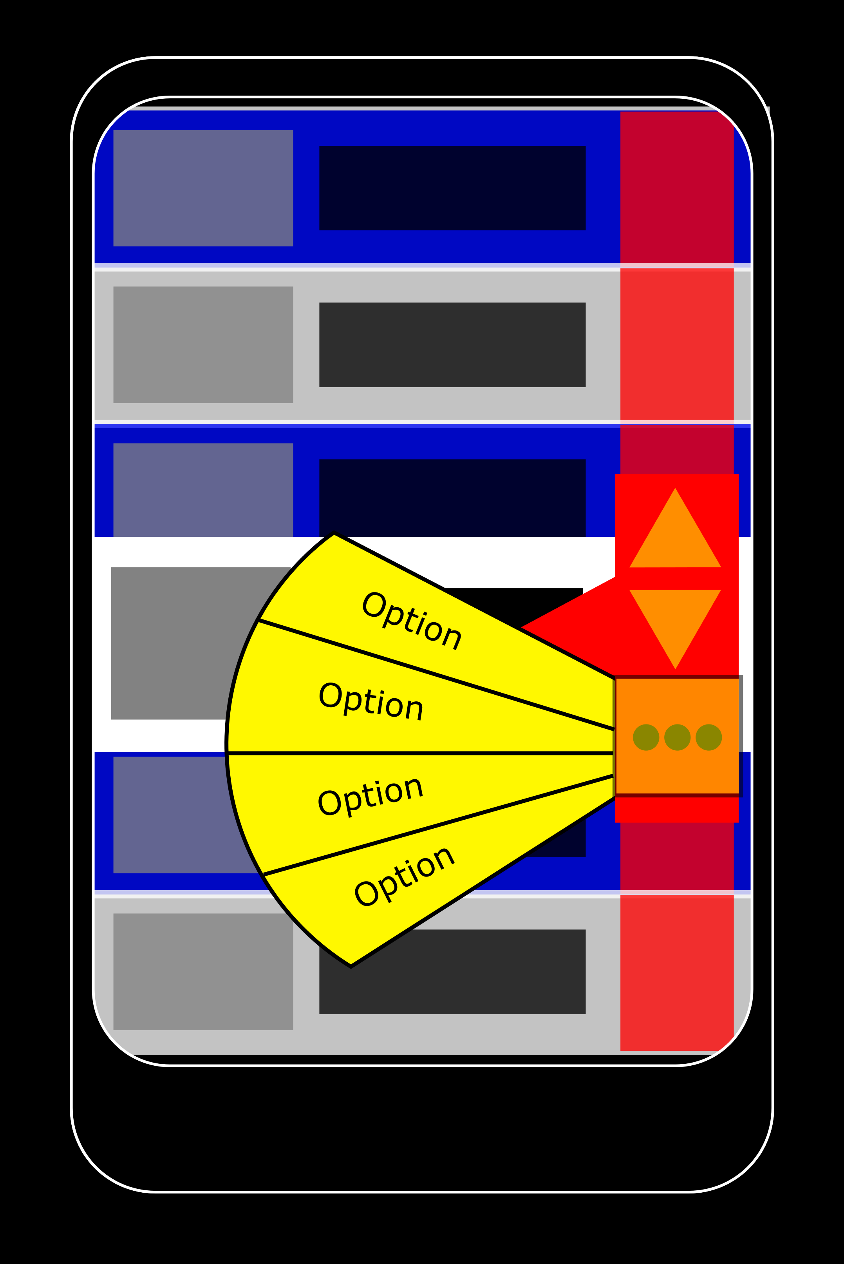
the walkthrough one example

Slide 79
summary
An app optimized for one handed use.
Takes in consideration the human biology and it’s limits
More thoughtful design
Considers all utility goals
Esp. efficiency, learnability and effectiveness

Slide 80
FFAudX
By: Darrel Holt & Lisa Her

Slide 81
What is FFAudX?
Extremely simple GUI that utilizes FFmpeg.
FFmpeg is command line software that allows users to do a variety of things: record, convert, and stream audio and video
FFmpeg uses libavcodec, the most up-to-date and powerful codec library.
Interaction type: instructing

Slide 82
What is FFAudX for?
Currently no simple GUI for FFmpeg - unsightly UI
Download audio/video from the web in the format you’d like
Automatic conversion during download
No terminal commands required
Notes:
All GUIs are currently overloaded with so many features they looks unsightly

Slide 83
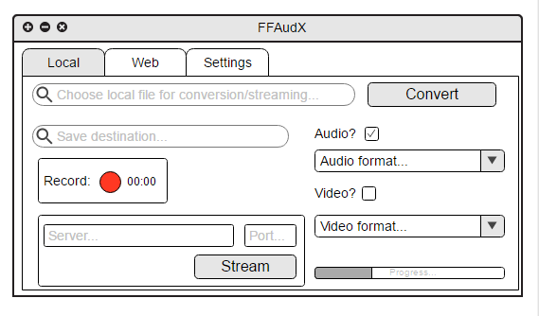
What FFAudX may look like

Slide 84
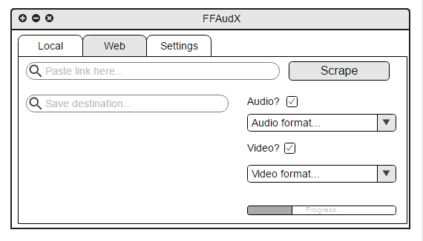
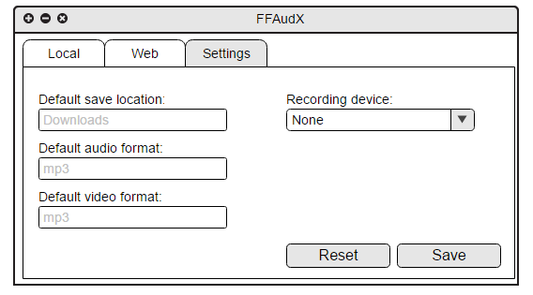

Slide 85
Summary
Interacting product is a GUI of FFmpeg which has various functions
Focusing on ability to convert audio types while there are other features
Simple design, easy to use, convenient, and is purposeful

Slide 86
PowerPoint Hub
Ali Noorani, Daniel Hong

Slide 87
Purpose
Create a web application that contains the lecture slides of all the classes on campus
Be more well-rounded graduates who know more than just what they majored in

Slide 88
Why do we need this?
Study for classes we will be taking in the future
Review material from previous classes
Self-paced learning

Slide 89
Mock-ups

Slide 90


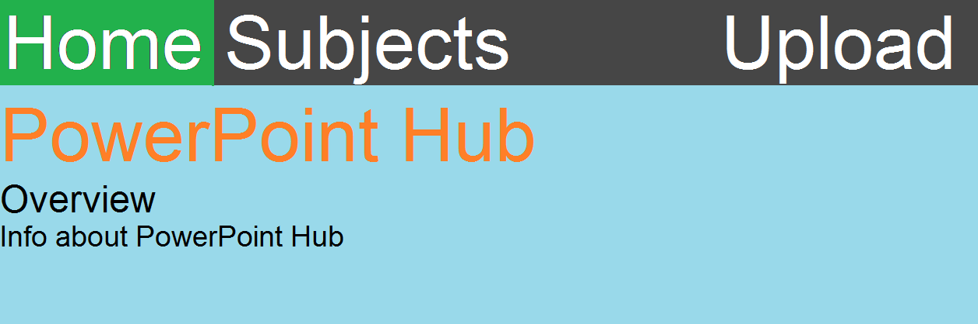
Home page

Slide 91
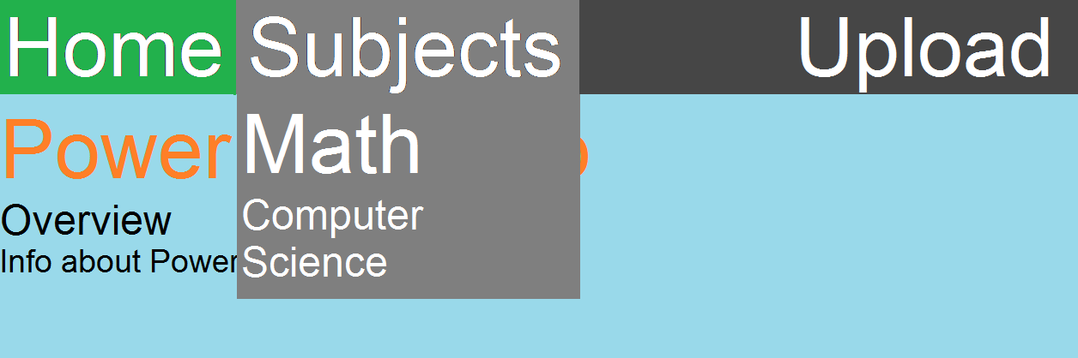
Hovering over subjects (instructing)

Slide 92
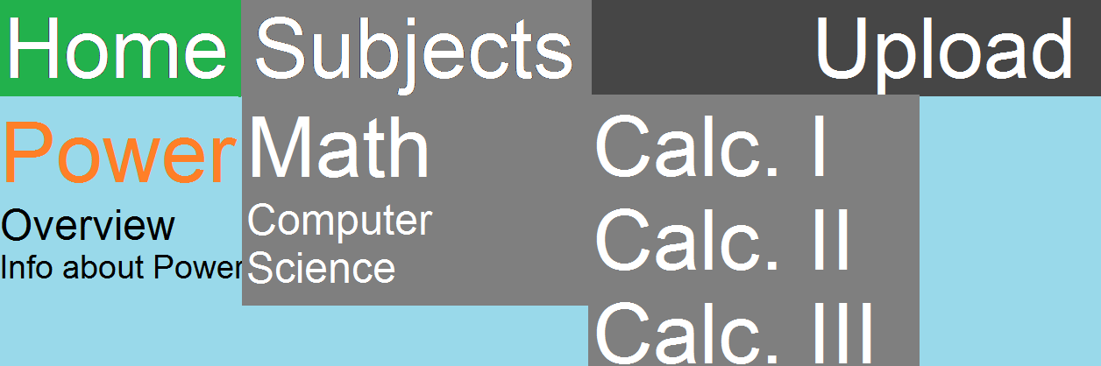
Hovering over math (instructing)

Slide 93
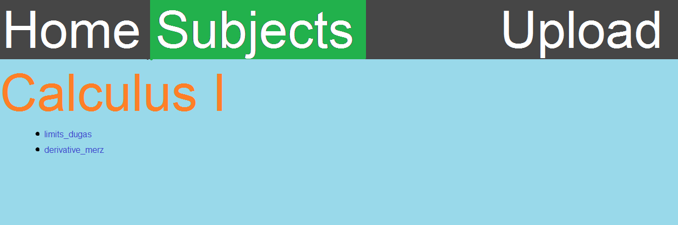
Sample calculus page (instructing)

Slide 94
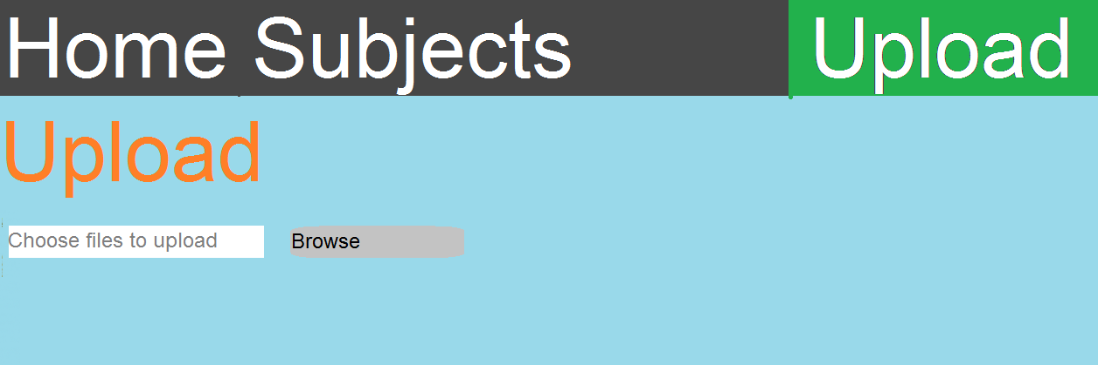
Upload Page (instructing/manipulating)

Slide 95
Summary
Public access to help the people less fortunate
Professors have a more positive impact on society
Great for learning what you care about
Can make you a more unique individual with a greater skill set

Slide 96
Rouge LIGHT A flash of the rouge Experience
Aung Kyaw & Zehao “Rex” Pan

Slide 97
Purpose
Entertaining
Easy to pick up but challenging
Tactical Stealth Game
One life
Once Chance

Slide 98
Why you should care
Challenge yourself mentally
Entertain yourself while waiting in line quickly
Play on the go

Slide 99
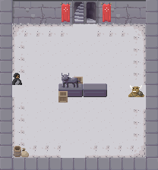
Mock-up

Slide 100
Summary
Turn based rouge like action based steal game.
Easily picked up to challenge yourself on the go.
One life, one try.

Slide 101
COMP 135 Final Project Proposal
Alison Shu
Justin Le
Dr. Cliburn
1/25/2017

Slide 102
HandyList
An android app that offers part-time job opportunity to the local community

Slide 103
What is HandyList?
Easy access to human resources
Local part-time job opportunity
Quick advisement for finding helpers in local community

Slide 104
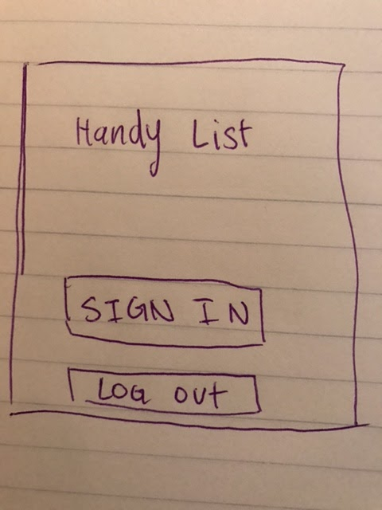
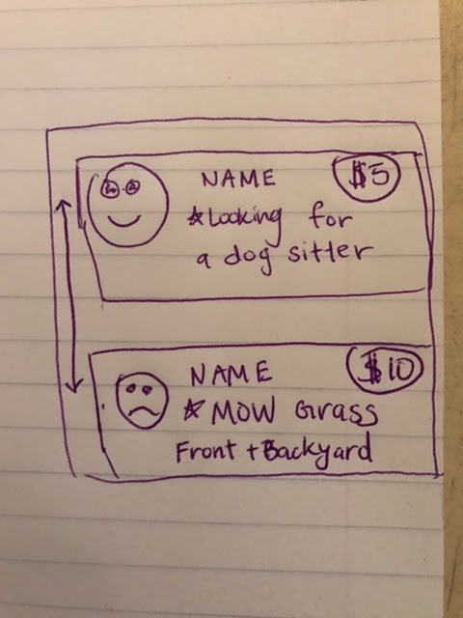
Potential Interface

Slide 105
Android App Features
User accounts with customizable profile
User can monitor advertisements for services
Chat message between vendor and customer
Geofence cities
Bonus: Online payment
Interaction Type
Instructing: Simple design with images to reflect certain functionalities

Slide 106
Thank you!

Slide 107
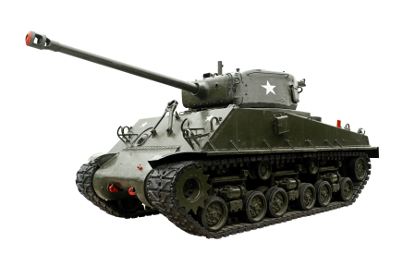
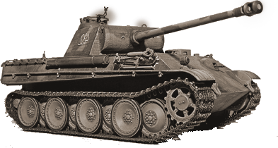
Tank Shooting Game
Devin Lim, Jeremy Ronquillo

Slide 108
Purpose
Mimic real-world physics for entertainment purposes.
Anybody can pick it up.
Can be beaten without taking a physics course.
Equation sheet provided.
Single player levels
Multiplayer battles

Slide 109
Goal of the Project
Help students taking physics understand trajectories.
Provide simulation outside of the labs.
Want users to have fun.

Slide 110
Equations that will be used
Projectile Motion Formulas :
V_{ox} = V_{o} * cosθ
V_{oy} = V_{o} * sinθ
X = V_{ox} * t
Y = V_{oy} * t - ½ * g * t²

Slide 111
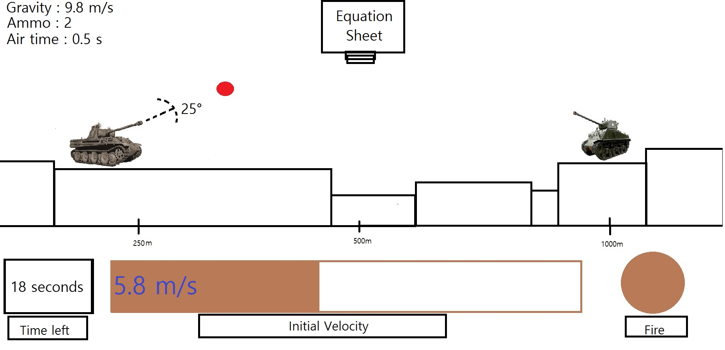
Sketch of the Project

Slide 112
Interacting with the Program
The predominant interaction type will be instructing.
User interacts with the angle bar and shooting button.
Clicking equation sheet tab displays a small screen with useful equations.
Arrow keys adjusts angle.
“Select Velocity” button begins moving the initial velocity bar.
“Select Velocity” button will then change to “Fire”.
Pressing “Fire” button with good timing locks in the initial velocity, angle, and releases the missile.

Slide 113
Conclusion
Physics may be difficult to visualize.
Program will bridge this gap with virtual resources for the user.

Slide 114
RateIt
Edgar Oregel & Gary Roberts

Slide 115
Purpose
Gesture controlled interface for browsing and rating Reddit content
Why?
Relaxed and fun way to consume and rate online content.

Slide 116
Features
Reddit Account login
Use gestures to control functionality
Thumbs up = Like/Favorite
Thumbs Down = Dislike
Point right = Next/Skip
Point left = Go back
Optional mouse based interface

Slide 117
Mock UI
Interaction Type: Instructing
Content Window
Camera
Username
Password

Slide 118
Summary
Fun and interactive way to use Reddit
Gesture controlled interface
Optional secondary controls for ease of use

Slide 119
AudioCatch!
By: Anthony Tran and Andre Ponce

Slide 120
What is “AudioCatch!”?
It is a rhythm game unlike any other rhythm game.
Instead of the usual button press, strum, and click to the beat of the music, you move your mouse over to corresponding “bars” in order to catch them along to the beat of the music.
The number and speed of the “bars” are generated using a system that reads the BPM of the selected song
The user can select their own songs to play
The user gains points for each note they “catch” with the mouse
If the user misses notes, they lose health. Health is regained by “catching” notes

Slide 121
Why should you care?
It would be a fun project to do
Rhythm games, in general, have the best and most stylized interfaces
It is unique, in terms of gameplay, in the rhythm game genre in America

Slide 122
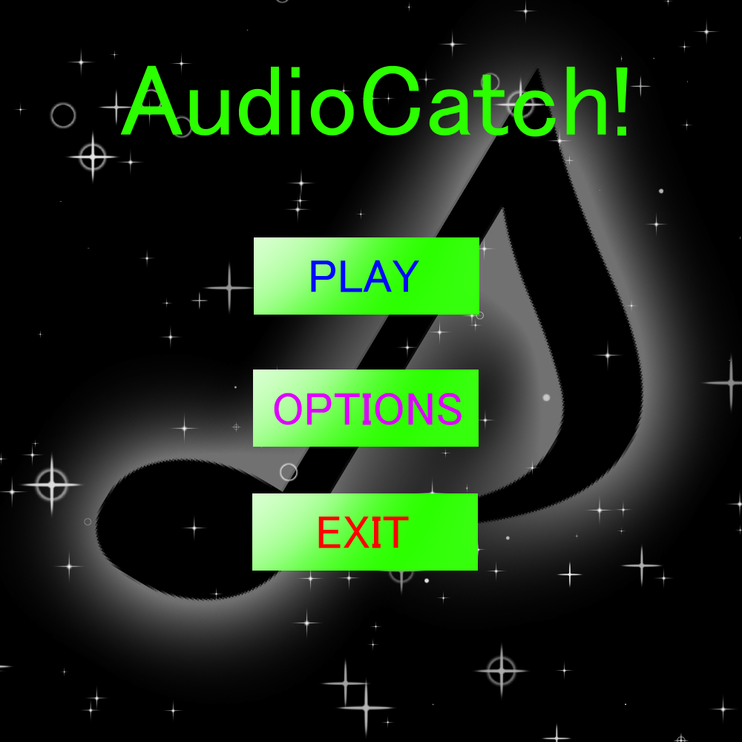
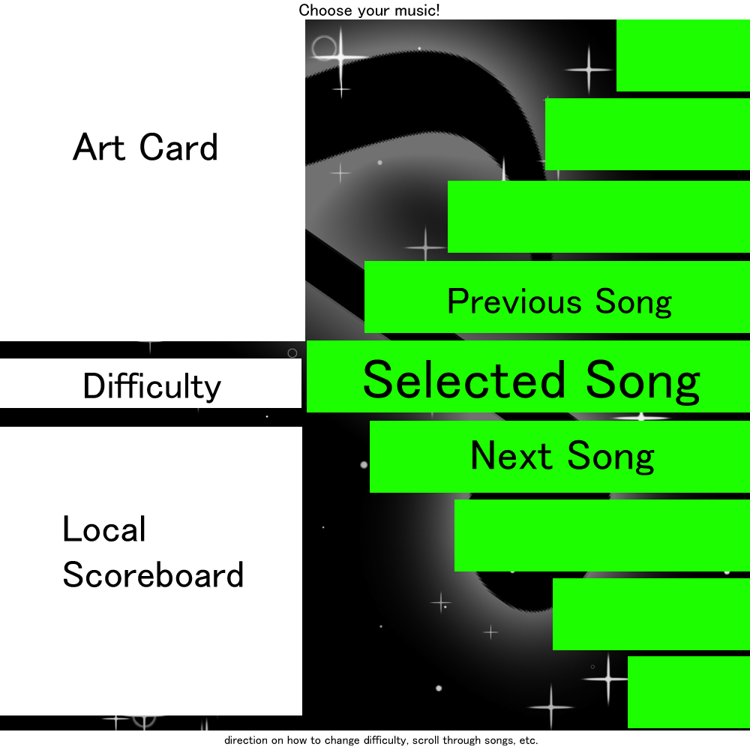
Start Menu and Music Selection
*these are concepts and in no way, shape or form, would it represent the final product*

Slide 123
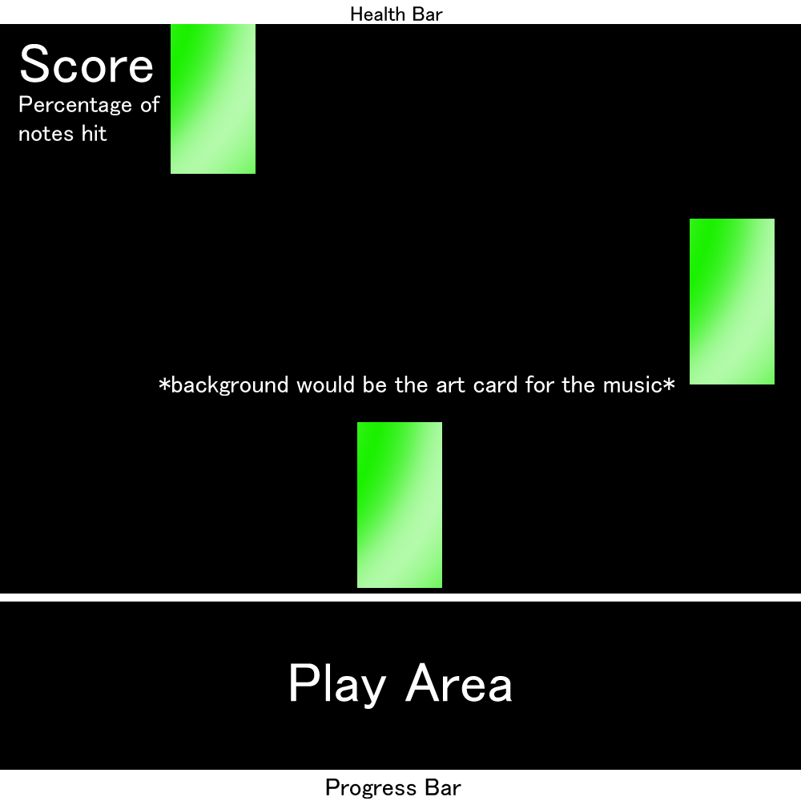
Gameplay Interface

Slide 124
Conclusion
A rhythm game meant for fun and enjoyment
More “casual” play style with just moving the mouse, but difficulty system would implement smaller bars (so you have to be more precise!)
Rhythm games, in general, are visually appealing with stylized interfaces
Who doesn’t enjoy listening to their music and moving to the beat?

Slide 125
“Shower Thoughts”
Austin Schafer, Carlos Flores, COMP 135

Slide 126
Purpose
Humor!
Crowdsourced highlights of http://just-shower-thoughts.tumblr.com/
Voted on by the users
Categorized

Slide 127
Why Should People Care?
The world’s stupidest online comedy club
Best content picked by the users
Absurdist humor: 60% of the time, it works every time

Slide 128
Mock-Up
Three Interfaces
2 Pages for viewing and submitting thoughts
1 Popup window for login

Slide 129
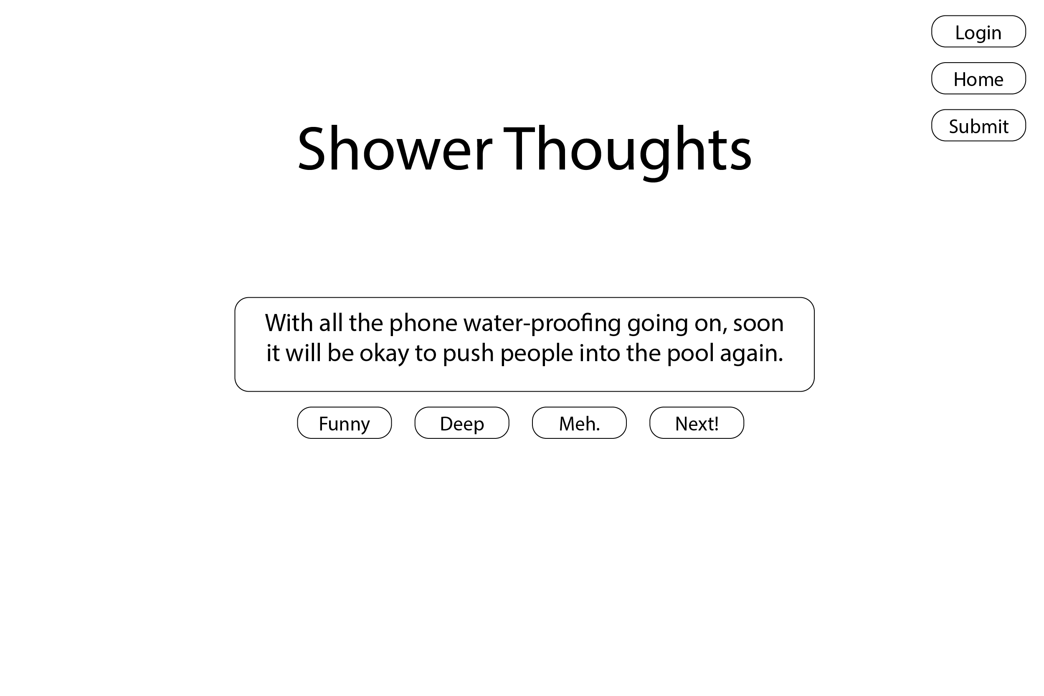
Home
Notes:
Vote Buttons Only Visible to Logged In Users

Slide 130
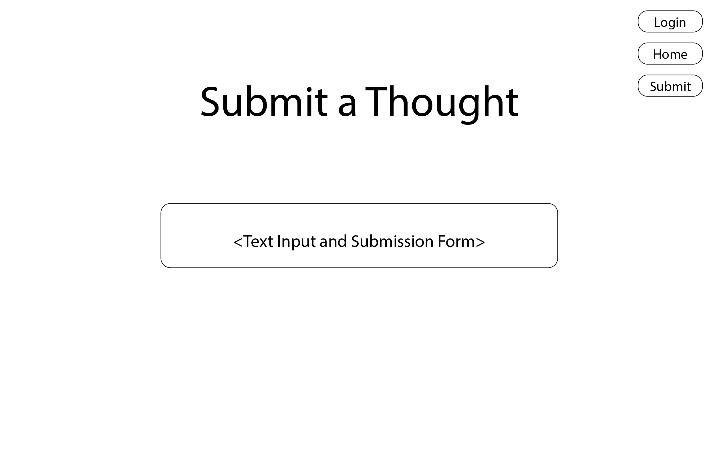
Submissions
Notes:
Clicking the submit button brings up the login window if the user is not logged in

Slide 131
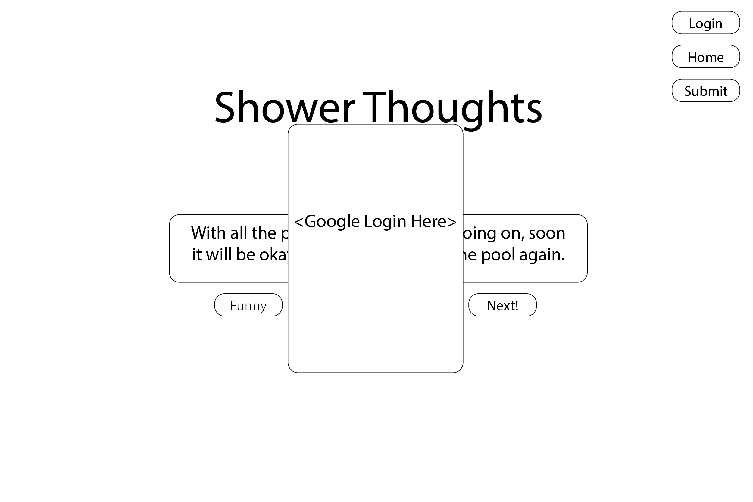
Login Window
Notes:
Google login api
Easy for us and the user and it’s secure

Slide 132
Summary
Humor crowdsourced and categorized
Voted on by the public

Slide 133
Tiger Eye
Sukhdip Singh
Caitlin Hamada
Notes:
App to inform people on events, clubs, and hangout areas on campus

Slide 134
App Description
Mobile App
Campus events, clubs, social areas
Made for UOP students

Slide 135
Why?
There’s not enough exposure to activities on campus for students
Assist students in exploring and getting to know their campus better

Slide 136
Mock up
Main Menu
Clubs
Club 1
Clubs
Club 2
Events
Club 3
Club 4
Social Areas
Club 5
Club 6
Notes:
Instructing and exploring

Slide 137
Mock up
Events
Event 1
Event 1
When: 1/31/17
Time: 3:00 pm - 4:00 pm
Insert Some Picture
Event 2
When: 2/02/17
Time: 3:00 pm - 4:00 pm
When: 2/02/17
Time: 8:00 pm - 11:00 pm
Description
Description of the event
Event 3
Where
Some location
Event 4
When: 2/10/17
Time: 3:00 pm - 4:00 pm
When
1/31/17
3:00 pm - 4:00 p.m.
Event 5
When: 2/11/17
Time: 3:00 pm - 4:00 pm
Event 6
When: 2/12/17
Time: 3:00 pm - 4:00 pm

Slide 138
Mock up
Sort by Category
Social Areas
Cultural
Game Room
Food
The Lair
Sports
Tiger Lounge
Activities
Multicultural Center
Religious
Music

Slide 139
Conclusion
This is an app to allow students to explore the events, activities, and clubs located on campus.
We hope that it will allow students to get to know the campus better.

Slide 140
Runner Lite
By Hilary Tong and Jason Jung

Slide 141
General Purpose
Mobile Runner
Gain experience in mobile development (ios and android)
Gain experience in the game engine Unity (C# and JavaScript)
3 certain actions to avoid or surpass obstacles
Reach to the end!
Multiple Levels

Slide 142
Why Should You Care?
Good experience in mobile application development
Reason to attempt coding in Unity
Make a character run into things

Slide 143

Mock up

Slide 144
Interaction Type
Predominate type: Instructing
Player will tell character to do 3 different functions: JUMP, SLIDE, DASH
Controlled by different screen interactions ( tap, hold, swipe)
Secondary type: Manipulating
Player can interact with game environment by breaking certain obstacles and collect items

Slide 145
One last thing
“You too can make people get distracted instead of doing their projects!”

Slide 146
Pen and Paper
Online notetaking application
Simple alternative to major document systems like Microsoft Word or Google Docs
Instruct the system to create new documents, then type out your document as you would any other text
System automatically organizes notes for users by keywords
Increases visibility by organizing notes for users
Save all notes online instead of carrying cumbersome notes around

Slide 147
Sign Out | Help ?
Create Note | Search
Recent Notes
Philosophy
Calculus
Spanish
Biology
Physics
Geology

